Slide 1
PWA
Progressive web app

Slide 2
What is a PWA ?
A web app that uses modern web capabilities to deliver an app-like experience to users without requiring them to install an app from the app store/ play store.
The best of web and the best of apps had a clone child — it is PWA

Slide 3
Features of PWA
The essential features like
no app submission
push notifications
faster loading time
SEO benefits
Reduce the cost of development and so on
Responsive
Works with any browser
Highly secured with the HTTPS

Slide 4
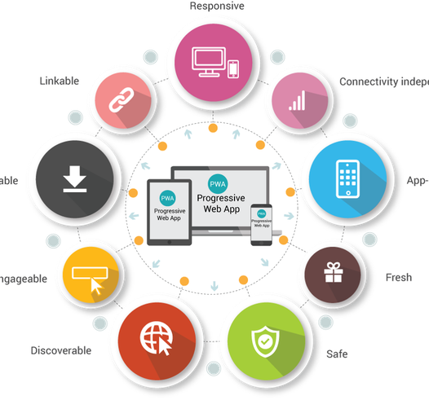
Requirements
Progressive
Responsive
Connectivity independent
App-like
Fresh
Safe
Discoverable
Re-engageable
Installable
Linkable
Offline Support

Slide 5
Why build a PWA ?
The cost of developing, testing, and maintaining applications.
The web page that can behave more like an app downloaded from the App Store/ Play Store.
Earned for a place in the notification tray and in the home screen just like an app.
Offline support and fast downloading time.
Add to Home Screen.

Slide 6
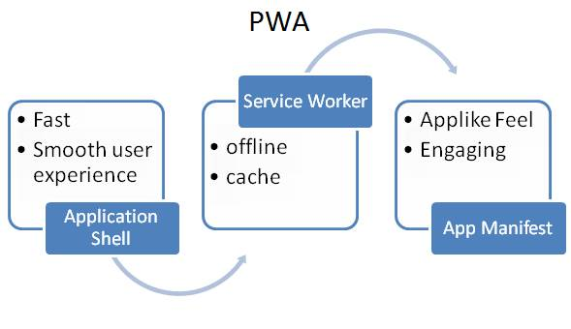
Components of PWA
Service Worker
App shell
App manifest

Slide 7
Service Worker
A service worker is a script that your browser runs in the background.
Its New features
Content caching
Background content updating
Push notification
Offline function to prior visited sites (that means, after the first visit to a website, the site and app will be reliably fast even on flaky networks).

Slide 8
Benefits of PWA
PWA supports the Offline Mode
Makes Use of Low Data
Push Notifications
Downloads are Fast
Best Option if Budget is less
No needed for app submission
Shows Positive SEO Results

Slide 9

Popular Clients

Slide 10
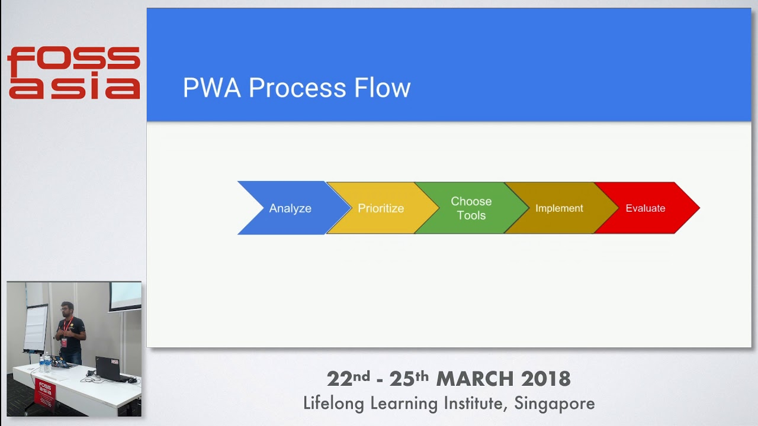
Creating a PWA
Analyse
Prioritize
Choose Tools
Implement
Measure and Evaluate

Slide 11

Analyse

Slide 12

Analysing Tool- LIGHTHOUSE

Slide 13
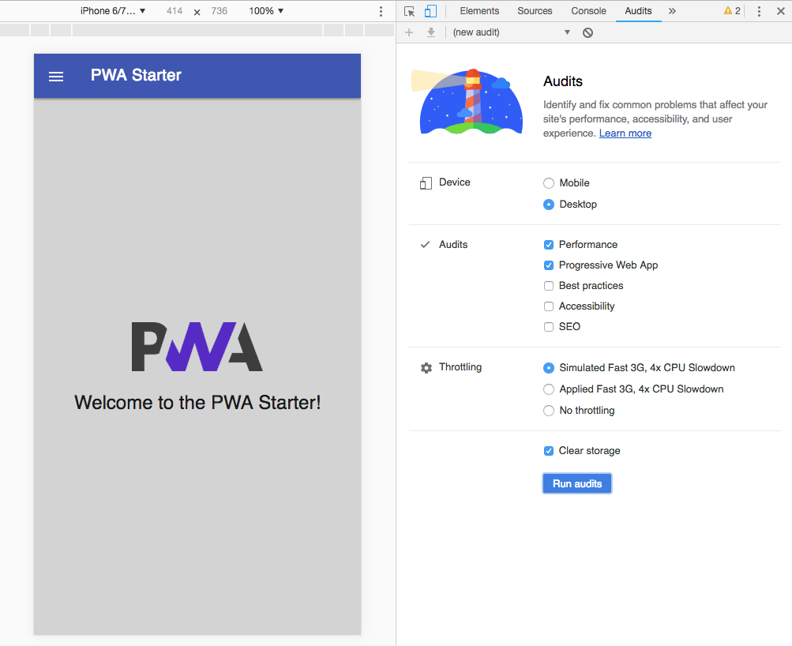
Run audit

Slide 14
Result

Slide 15
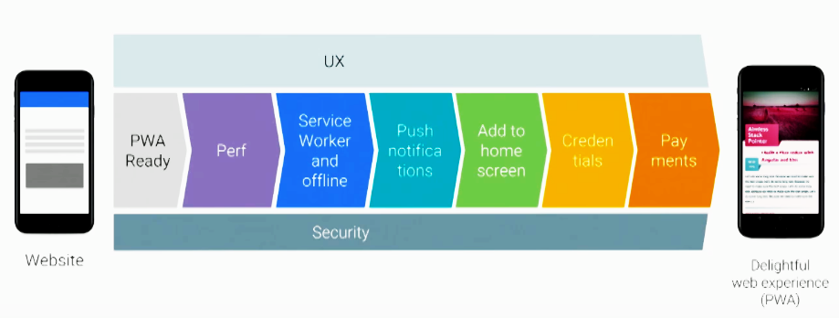
Prioritize

Slide 16

User Experience

Slide 17

Choose Tools
Includes,
Pre-caching
Runtime caching
Strategies
Request routing
Background sync
Helpful debugging
Greater flexibility
feature set than sw-precache and sw-toolbox

Slide 18
Implement
Don't block transitions on network
Prevent content jumping - Unstable load
Cache the right thing at the right time
Avoid scrolling glitches

Slide 19

Measure and Evaluate

Slide 20
Conclusion
Getting a good positive response from the web and mobile app development Industry
It has a number of advantages and features that can take any business to a result-oriented position
They also make the job of the app developers much more easily reducing the overall cost and time of development

